Slide 1

Hotel Management System
This SQL project is designed to manage and streamline hotel operations by maintaining and querying data related to guests, bookings, and financial transactions. The database schema includes tables for guests and bookings, capturing essential details for efficient hotel management. Below queries to interact with and analyze the data within this system.
basnagouda sb

Slide 2
Database Schema
Guests Table
Bookings Table
The Guests table stores information about each guest, including their name, contact details, and address. This table is essential for tracking guest information and ensuring accurate records.
The Bookings table holds details about each booking, such as the guest's ID, room number, check-in and check-out dates, and the total amount paid. This table is crucial for managing bookings, generating reports, and analyzing revenue.

Slide 3

Data Insertion
1
Guest Records
The code snippet inserts records into the Guests table, providing details about each guest, including their name, email, phone number, address, and city.
2
Booking Records
This code snippet inserts records into the Bookings table, capturing information about each booking, including the guest's ID, room number, check-in and check-out dates, and the total amount paid.

Slide 4
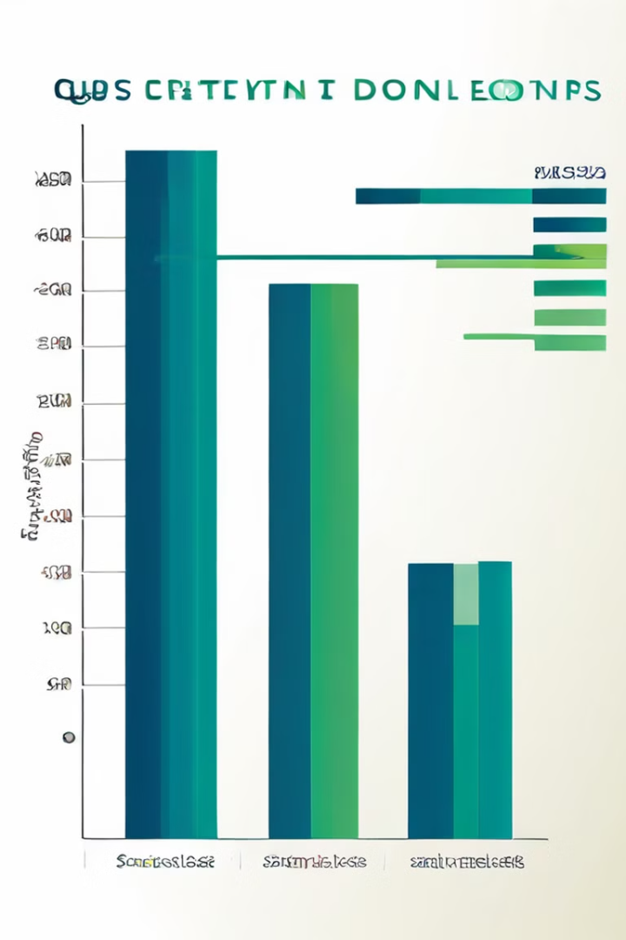
Query 1: Most Frequent Guest
This query identifies the guest who has made the most bookings. It uses a combination of JOIN, GROUP BY, and RANK functions to calculate the booking count for each guest and then rank them based on the count. The query then selects the guest with the highest rank, indicating the guest with the most bookings.

Slide 5

Query 2: Guests with Bookings in Specific Dates
This query retrieves a list of guests who have bookings within a specific date range. It uses INNER JOIN to combine data from the Guests and Bookings tables, and a WHERE clause to filter bookings based on the check-in date. The DISTINCT keyword ensures that each guest is listed only once, even if they have multiple bookings within the specified period.

Slide 6

Query 4: Total Revenue
This query calculates the total revenue generated from all bookings. It uses the SUM function to aggregate the amount paid for each booking, taking into account the duration of the stay. The query uses a CASE statement to handle bookings where the check-in and check-out dates are the same, ensuring accurate revenue calculation.

Slide 7

Query 5: Average Stay Duration
This query calculates the average stay duration of guests. It uses a CTE (Common Table Expression) to calculate the stay duration for each booking, taking into account bookings where the check-in and check-out dates are the same. The AVG function is then used to calculate the average stay duration from the CTE.

Slide 8

Query 6: Guests with Multiple Bookings in Same Room
This query identifies guests who have booked the same room multiple times. It uses INNER JOIN to combine data from the Bookings and Guests tables, and GROUP BY to group bookings by guest name, guest ID, and room number. The HAVING clause filters the results to include only guests with more than one booking in the same room.

Slide 9

Query 7: Top 2 Guests by Total Amount Spent
This query identifies the top two guests based on their total amount spent. It uses INNER JOIN to combine data from the Guests and Bookings tables, and GROUP BY to group bookings by guest ID and name. The SUM function calculates the total amount spent for each guest, and the ORDER BY clause sorts the results in descending order based on the total amount spent. The TOP 2 clause limits the results to the top two guests.

Slide 10

Query 8: Average Amount Spent by Guests with Long Stays
This query calculates the average amount spent by guests who have stayed for more than 3 days. It uses a CTE (Common Table Expression) to calculate the stay duration for each booking, and a WHERE clause to filter bookings where the stay duration is greater than 3 days. The AVG function is then used to calculate the average amount spent for these long-stay guests.

Slide 11
Query 9: Guests with Most Bookings
This query identifies the guests who have made the most bookings. The query combines data from the Guests and Bookings tables using an INNER JOIN, and then groups the bookings by guest ID and name. The COUNT function is used to count the number of bookings for each guest, and the ORDER BY clause sorts the results in descending order based on the number of bookings. The TOP 2 clause limits the results to the top two guests with the most bookings.

Slide 12
CONCLUSION
SQL project is designed to manage and streamline hotel operations by maintaining and querying data related to guests, bookings, and financial transactions. The database schema includes tables for guests and bookings, capturing essential details for efficient hotel management. Below are the T-SQL queries to interact with and analyze the data within this system.

